Slide 1

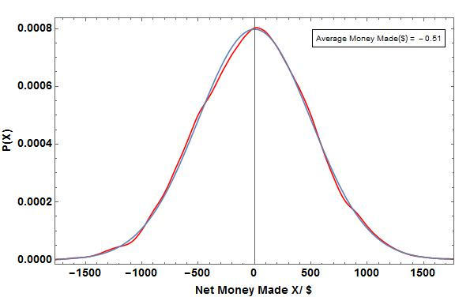
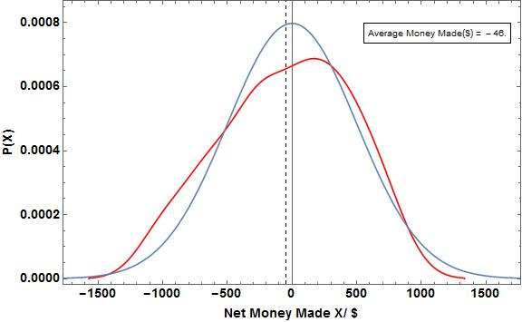
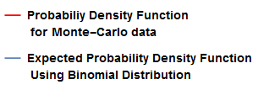
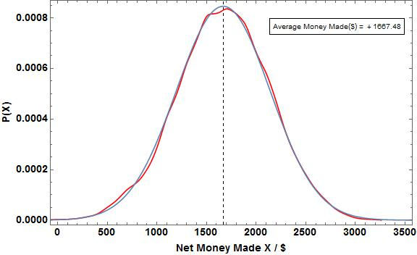
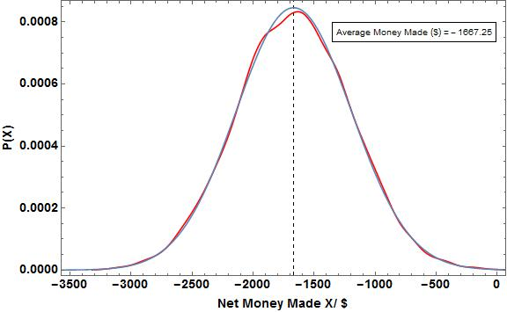
The Gambler’s Ruin: Mathematics of Gambling
Omair Alam, Computational Methods in Physics, Spring 2015
Introduction:
Gamblers know that there are regular patterns to chance—although not all of their cherished beliefs survive mathematical analysis. In order to test the validity of their beliefs we using Monte-Carlo simulations to calculate the average earnings or losses in a game of die rolls under varying rules of winning. We further simulate a game of Craps with both a biased and unbiased die. For a dice roll game, we use a Binomial Distribution to model the expected earnings while for a Craps game, we use axiomatic derivations to calculate the expected probability of winning. We then compare the expected earnings with the actual earnings for a varying number of repetitions to understand the fate of the Gambler’s money after betting under certain game rules repeatedly.
Plots For Roll Die Game Representing Expected and
Monte- Carlo Data
Legend
Figure 1: Probability Distribution for a roll die game with a Fair Dye i.e. P(W) = P(L) for 1000, 000 trials
Figure 2: Probability Distribution for a roll die game with a Fair Dye i.e. P(W) = P(L) for 10, 000 trials
Physics and Methods:
We conduct two sets of experiments of which the first is related to rolling a die and the second is related to playing a game of Craps.
The rules of the Monte-Carlo simulation for the die roll game are as follows:
We start with a base amount i.e. the money we start the game with,
Every roll, if we get a favorable score, we gain a certain amount x, otherwise, we lose the same amount x,
We keep playing till we either get a net amount greater than a certain amount Z, or lesser than a certain amount Y, or if we exhaust the number of games we can play. Net Amount is defined as,
Net Amount = The Score of Each Game – base Amount
We find the frequencies of each net amount, and normalizing the data to get the probabilities of attaining each net amount as well as the average earing.
We use the following Normal Distribution Formula in order to find the expected earnings for each Net Amount.
The rules of the Simulation for a single game of Craps are as follows:
If the sum of the two dies, X, is 7 or 11 we in the game
If X 2, 3 or 12, we lose the game
In X has any other value, we keep rolling two dies again till we either match that value of X again in which case we win, or we get a value of 7 for X, in which case we lose.
We simulate this game using both a fair and unfair die and calculate the probability of winning. We use an axiomatic derivation to calculate the expected probability of winning in both cases and compare these values.
Figure 5. Figure caption should give enough detail to describe the figure above with out reading much else
Figure 3: Probability Distribution for a roll die game with an Unfair Dye i.e. P(W) = 4/6 and P(L) = 2/6 for 1000, 000 trials
Figure 4: Probability Distribution for a roll die game with an unfair Dye i.e. P(W) = 2/6, P(L) = 4/6 for 1000, 000 trials
Table Of Expected Values for Craps Expected and
Monte- Carlo Data
Number of Trials | Estimated Probability of winning with Fair Die | Expected Probability of winning with fair Die | Estimated Probability of winning with Unfair Die | Expected Probability of winning with Unfair Die
10 | 0.600 | 0.493 | 0.800 | 0.524
10000 | 0.498 | 0.493 | 0.532 | 0.524
100000 | 0.491 | 0.493 | 0.524 | 0.524
Figure 6. Figure caption should give enough detail to describe the figure above with out reading much else
Table 1: The Fair die has equal probability of 1,2,3,4,5 and 6.
The unfair die has P(1) = 1/13, P(2) = 2/13, P(3) / 2/13, P(4) = 2/13, P(5) = 2/13 and P(6) = 4/13
Conclusions or Discussion:
Give an overall conclusion of your results. What do they show. Is there agreement with experimental data? Or observation? What is the big picture. Include any problems, corrections and limitations to you code. Interesting next steps…
Results:
Write the results of you problem. We saw this… as shown in figure 1. The figures should display most of your results from the project this is an additional area for words but remember figures are better than words. For example with shooting the sun you can show a few plots where you track a projectile. One where you tested you code by orbiting the sun with the projectile and eliminating the earth. Then one or two with example trajectories. Then figure X showing the plot of many angles and launch velocities. You should reference every figure.
References:
Text 1 that was used
Article 2 that was used
Reference 3 that was use

